Slide 1
Autostack
Frank Wu, Tony Xu, Anson Lu, Yingming Ma

Slide 2
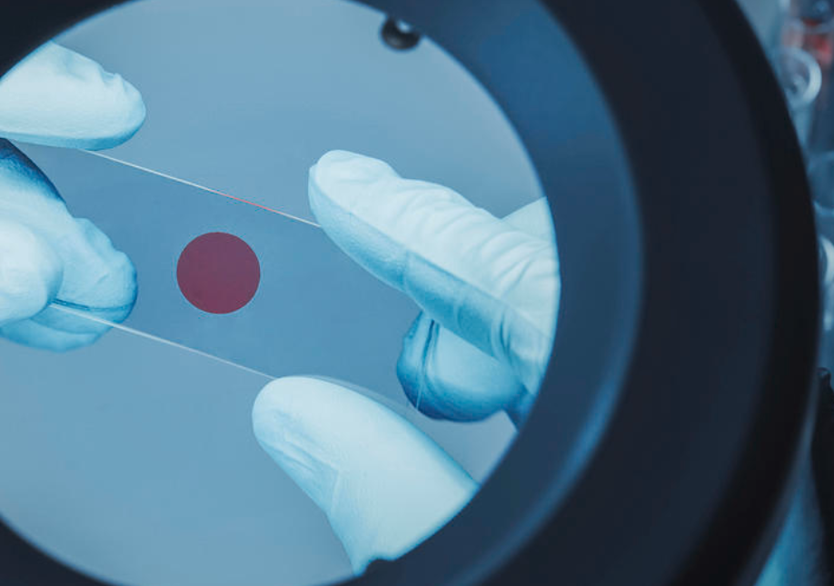
Background
When using microscope to observe samples, manually aligning sample plates is time consuming and visually exhaustive
Manual alignment is prone to errors and human mistakes
Building an alignment system for stacking the 2D materials

Slide 3
Goal
Current alignment relies on human visual judgment, we will design a computer vision model
Need
Automatically detect flakes
Extract flake position & size
Provide real-time feedback for motion control
Our Direction
Edge Detection
YOLO Recognition
Integrate with Raspberry Pi 5

Slide 4
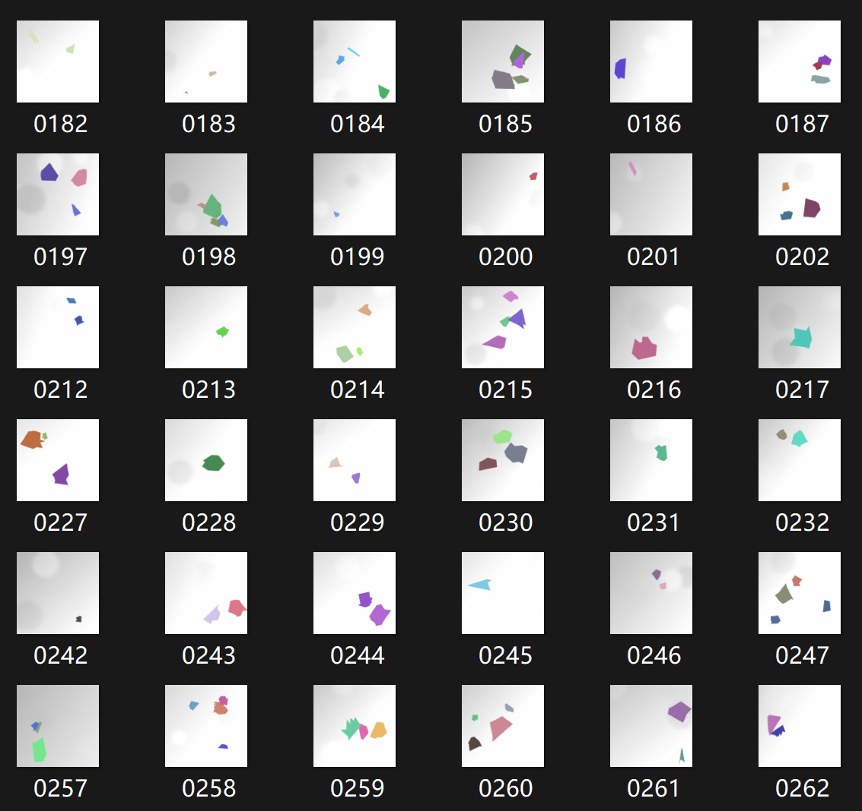
Yolo Recognition
Difficult to find a large dataset of 2D material flakes online
Use code generated shapes to mimic actual flakes, providing a large enough dataset

Slide 5
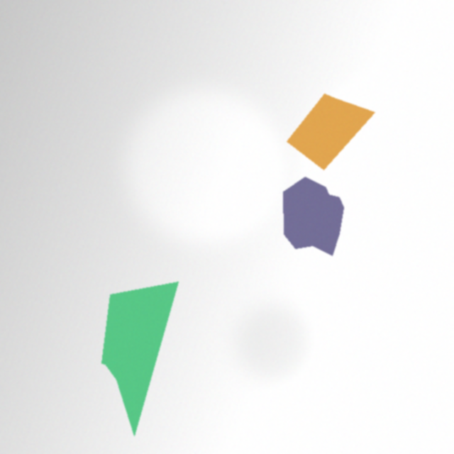

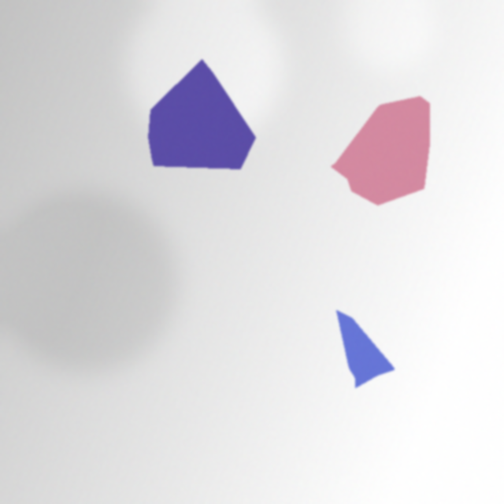
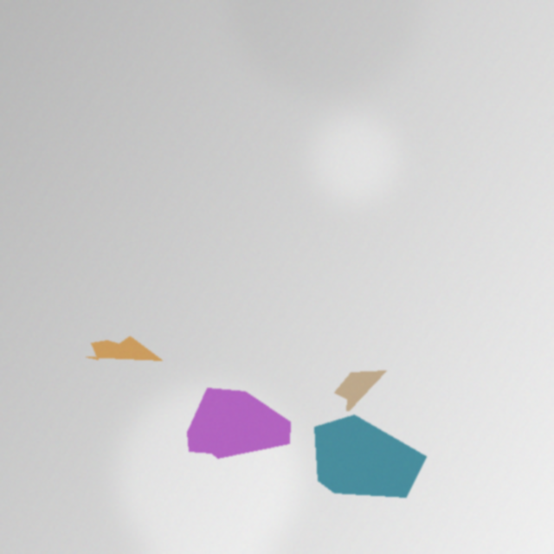
Training dataset
The generated flakes resemble to real flakes and real circumstances when using a microscope
They have random shapes, sizes, and colors
There are random light spots and dark spots in the image
The brightness of image varies

Slide 6
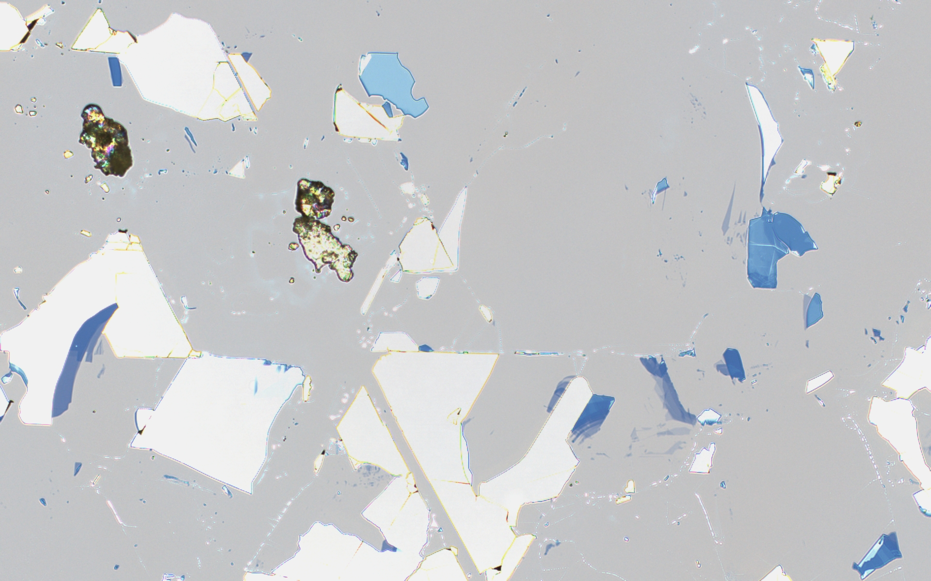
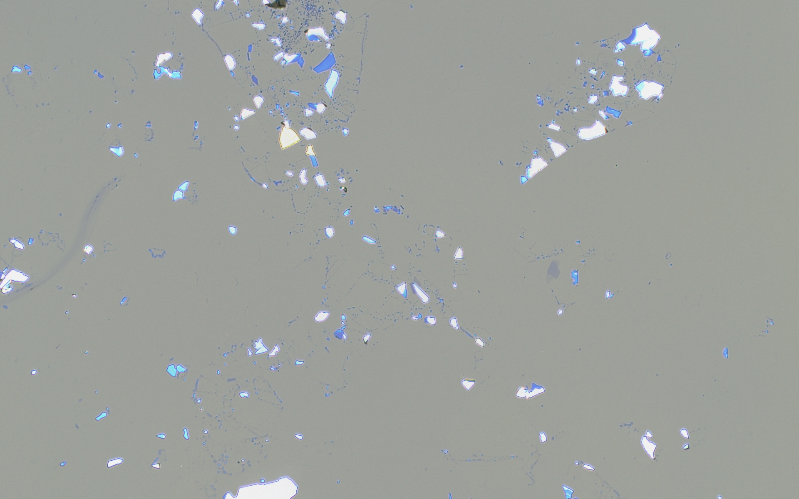
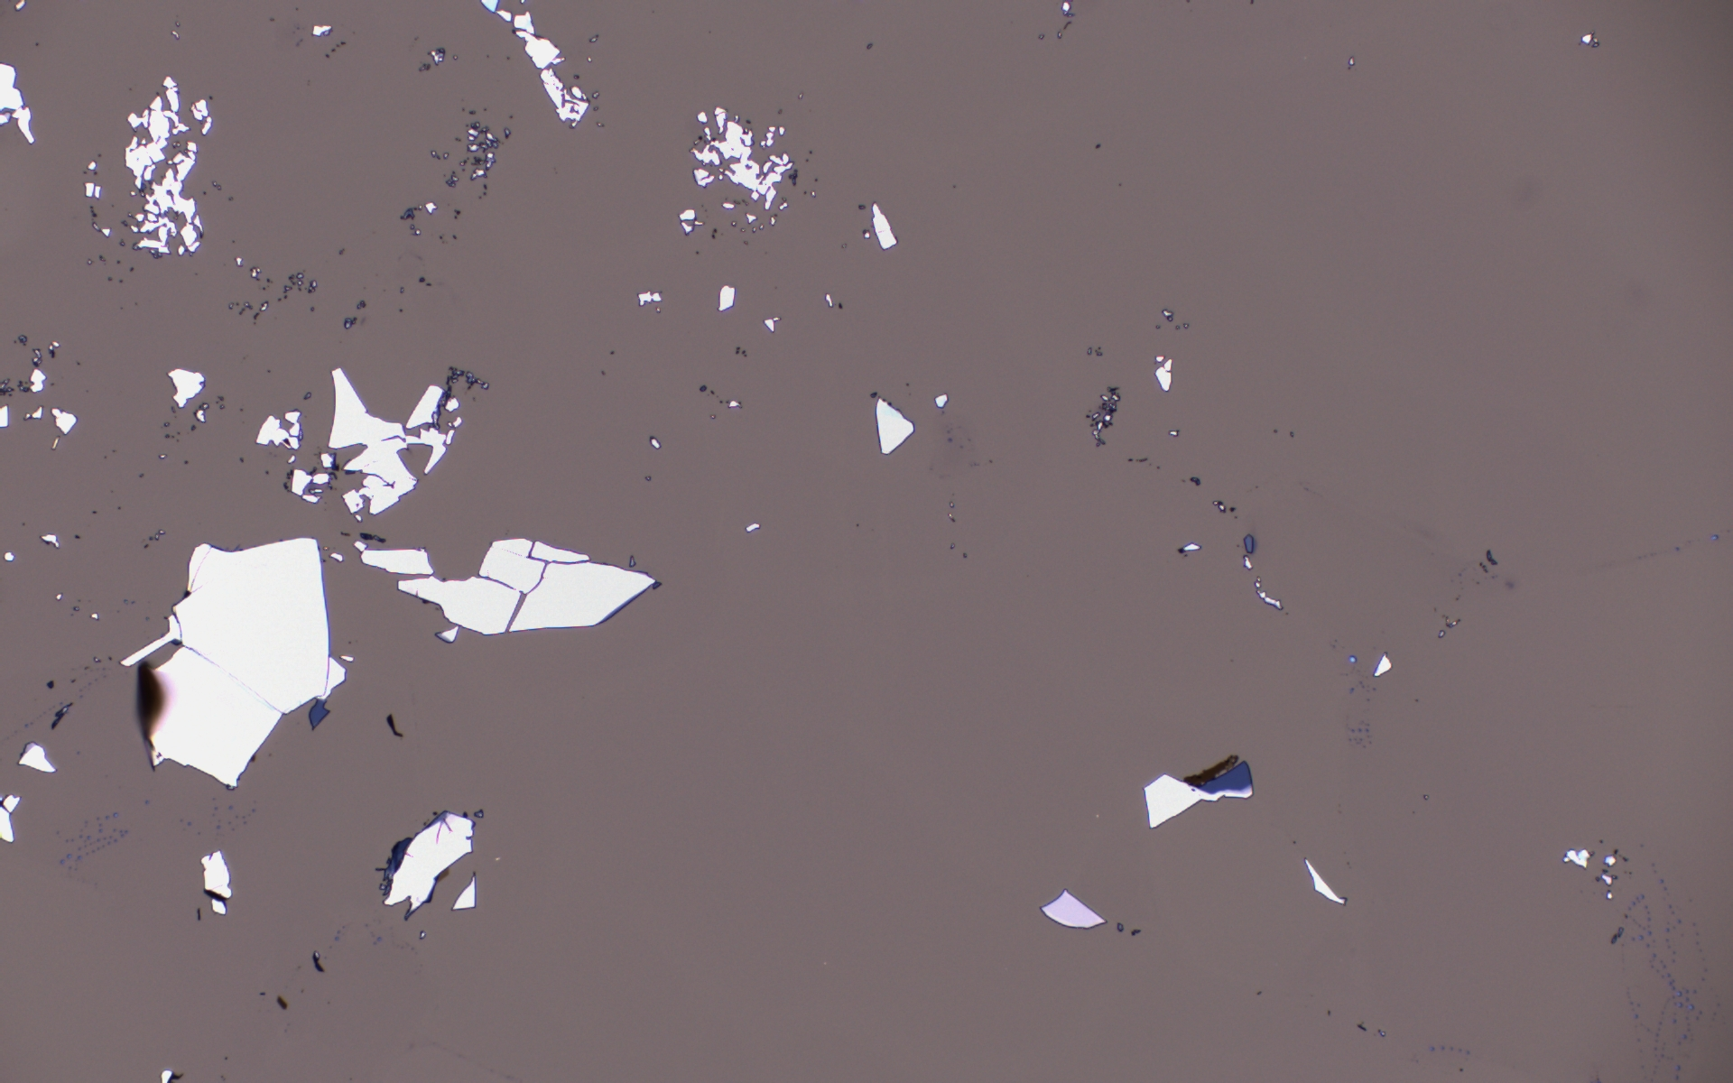
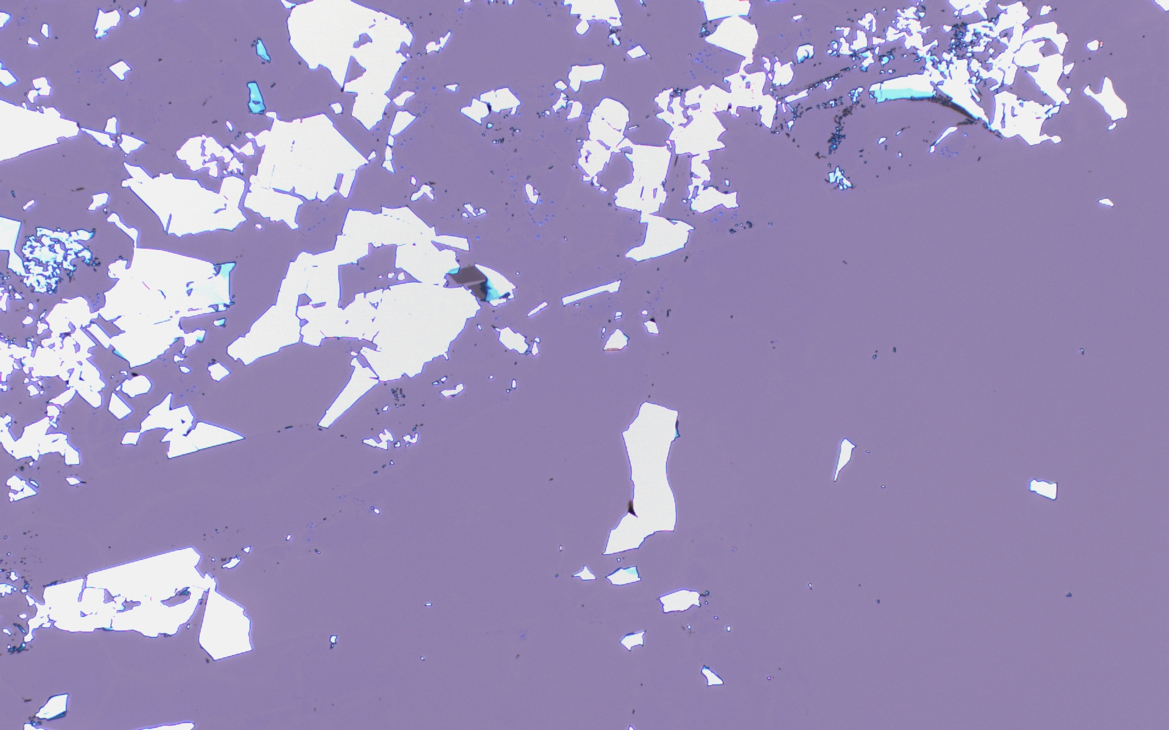
Training Dataset
In addition to the 500 generated images of flakes, we also found public dataset that includes 55 real microscope flakes images, we used 8 of them in validation dataset
We manually labeled the flakes in these images

Slide 7
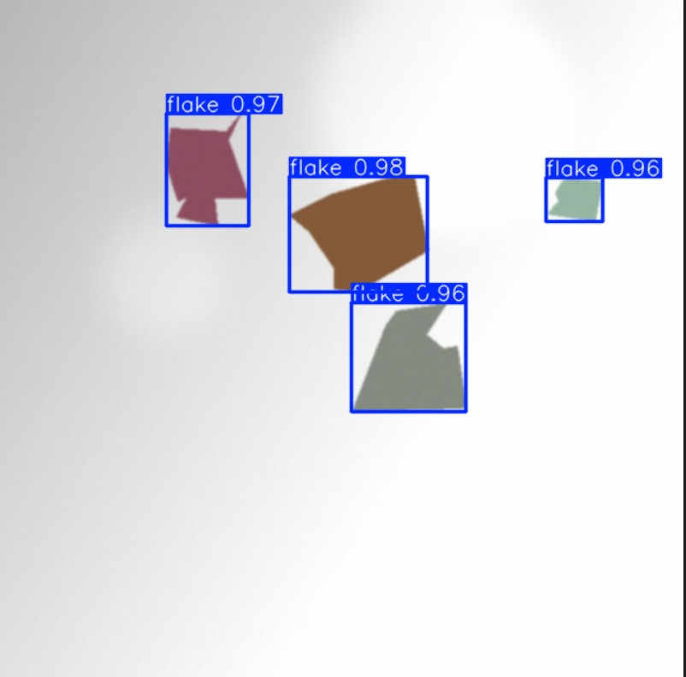
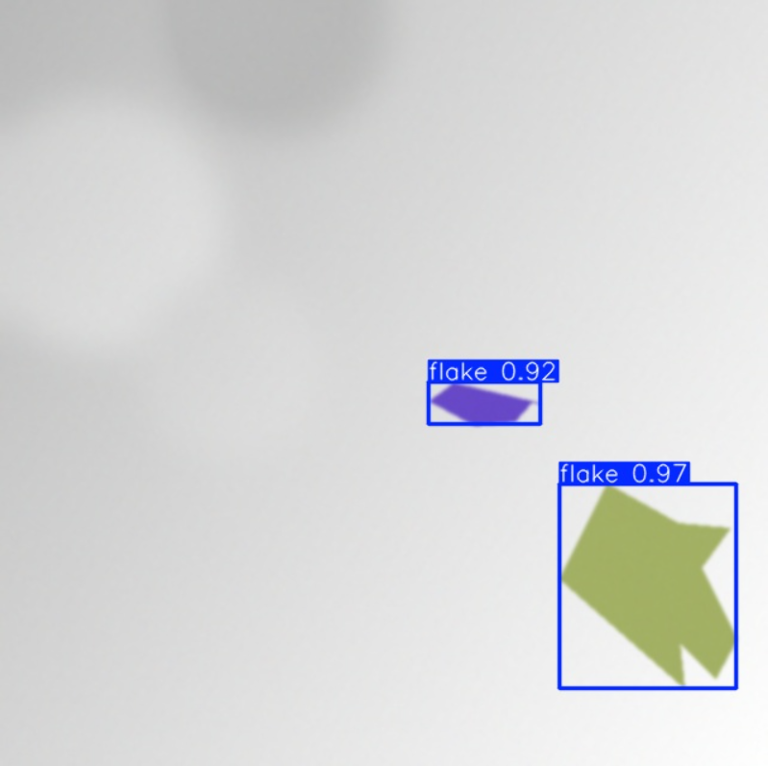
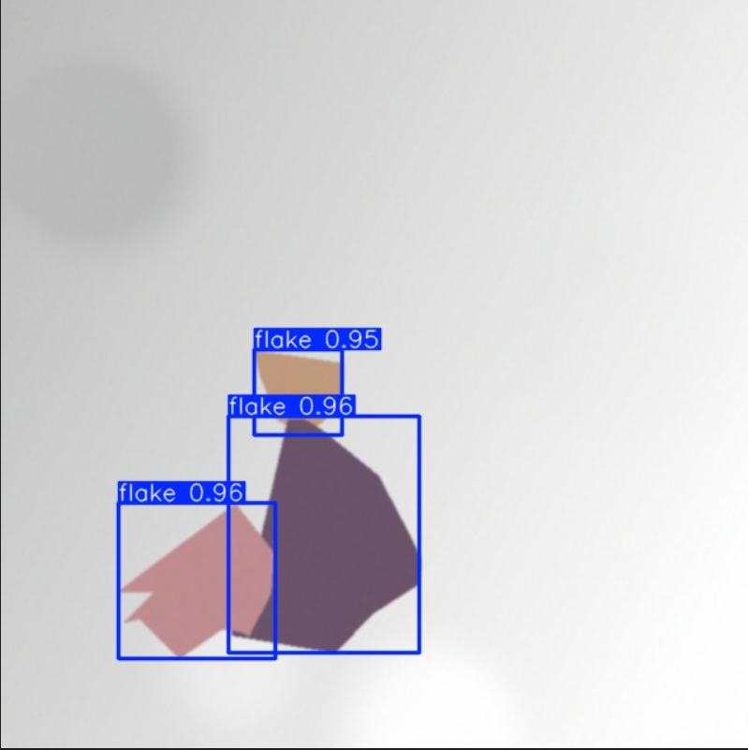
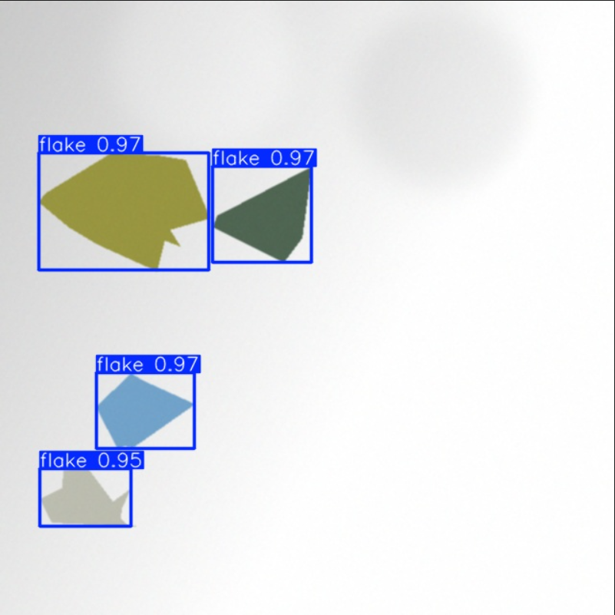
Yolo Recognition Model

Slide 8
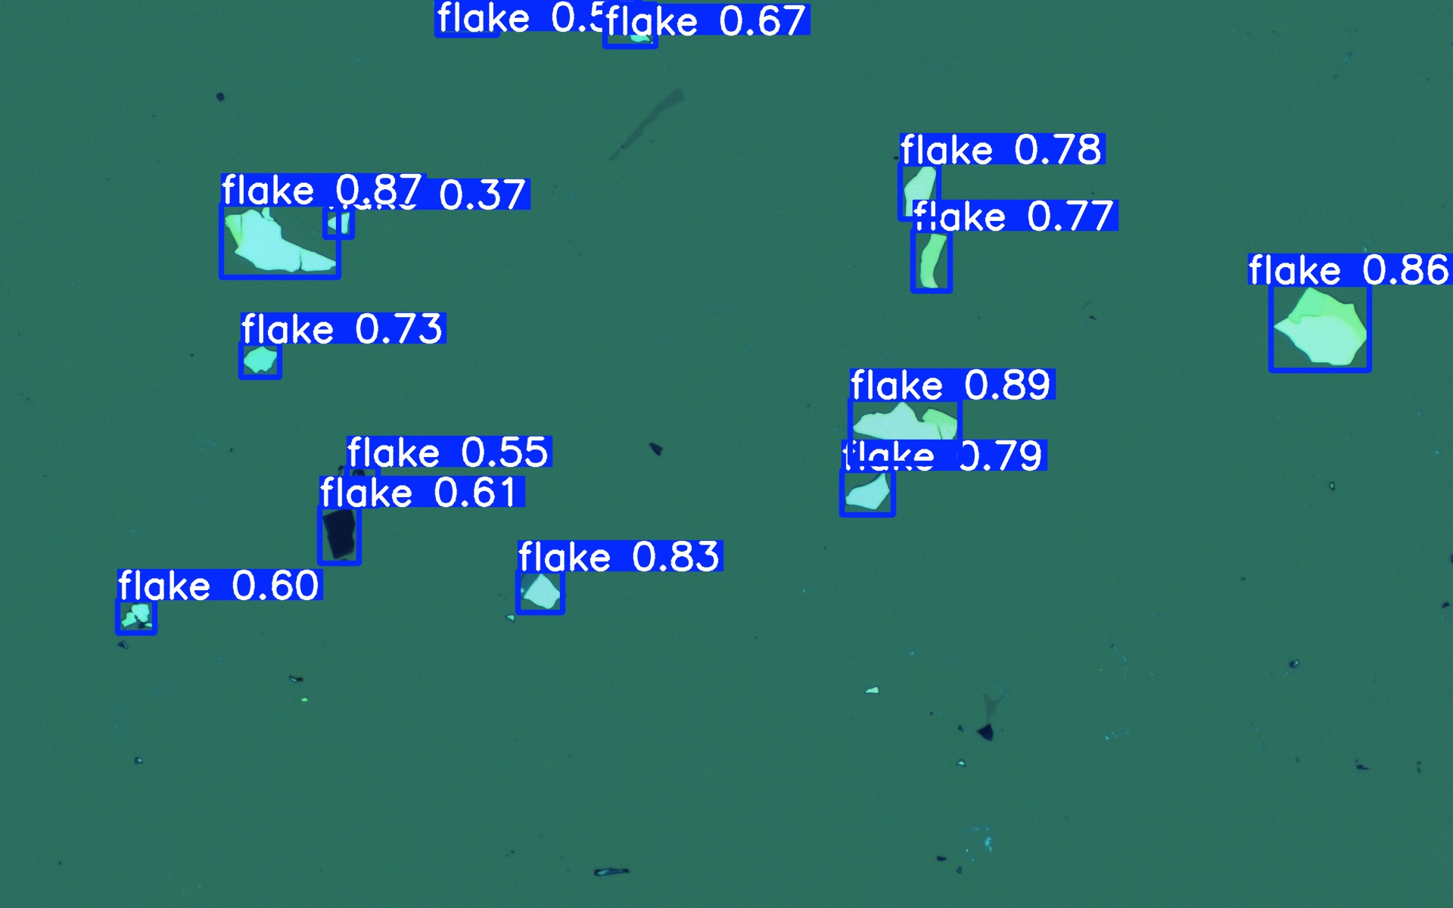
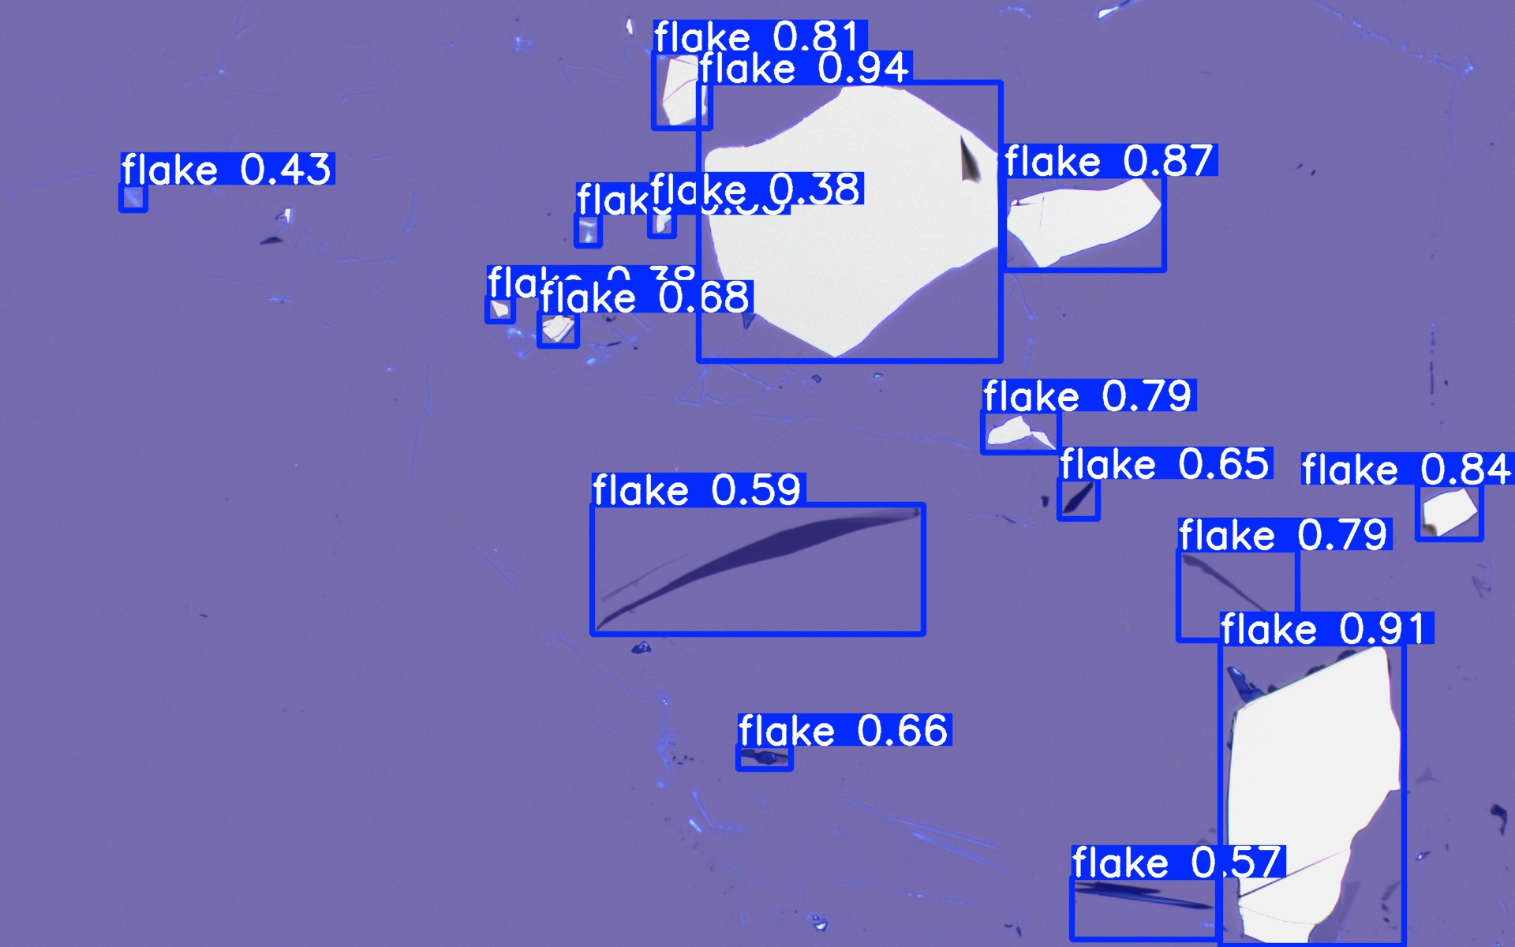
Yolo Recognition Model

Slide 9
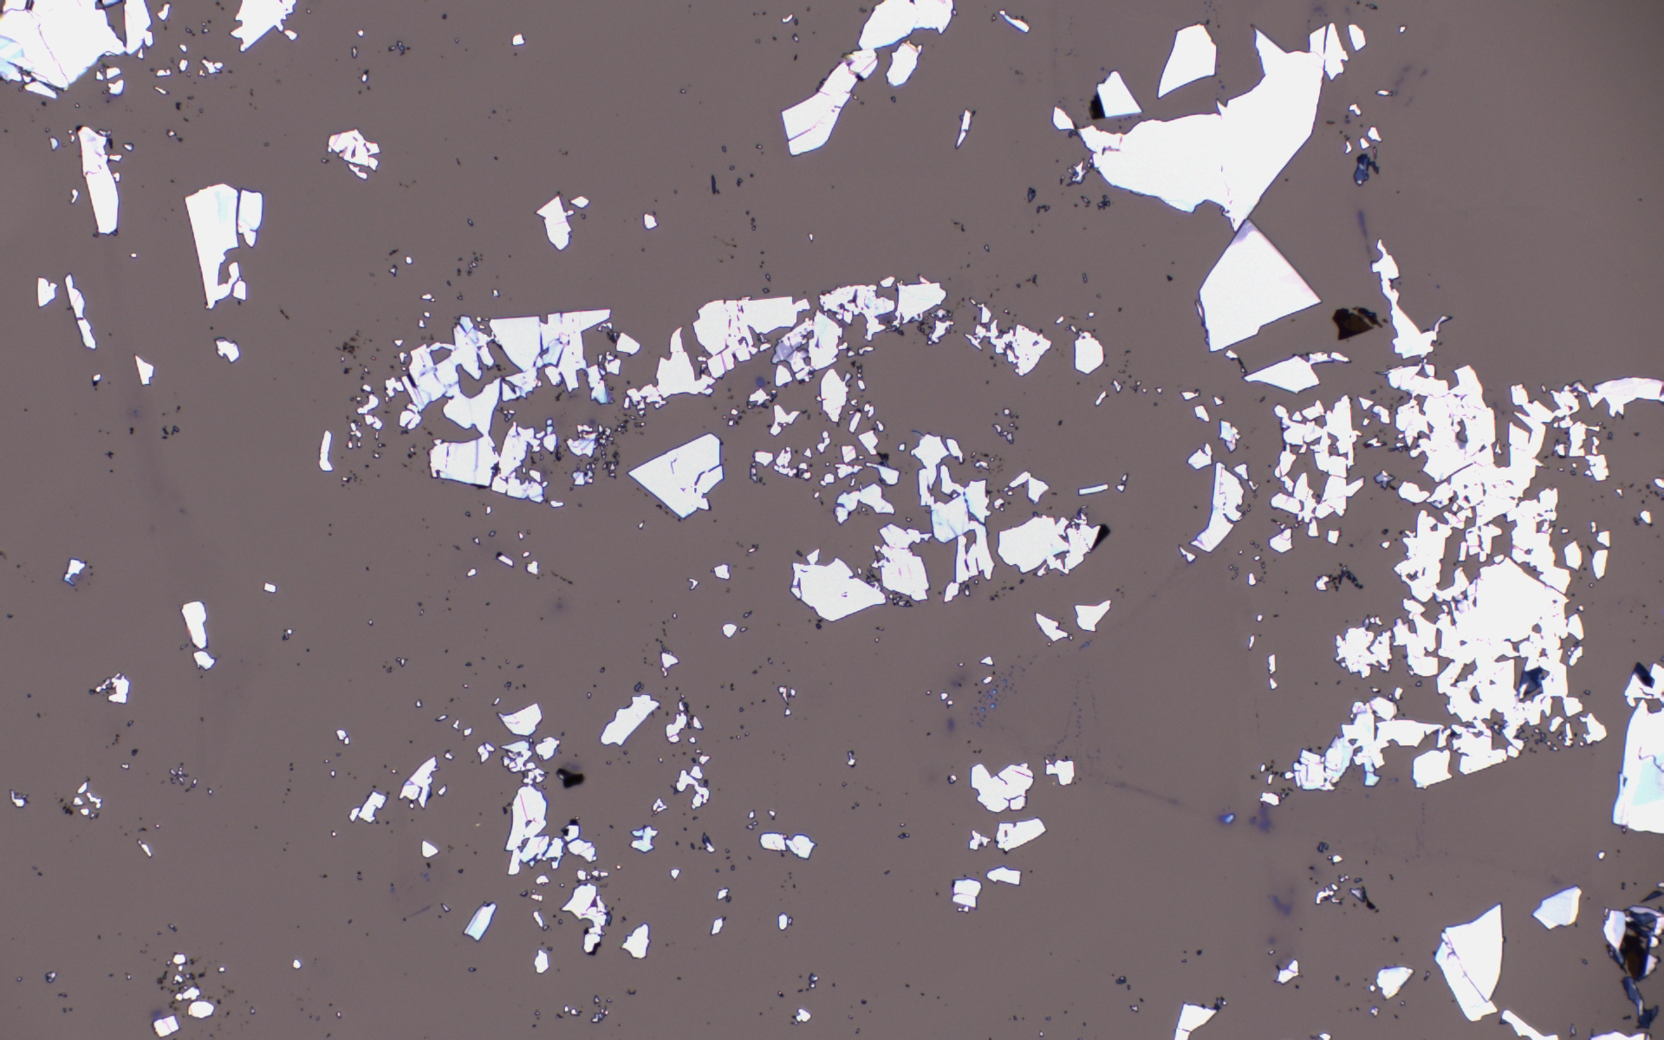
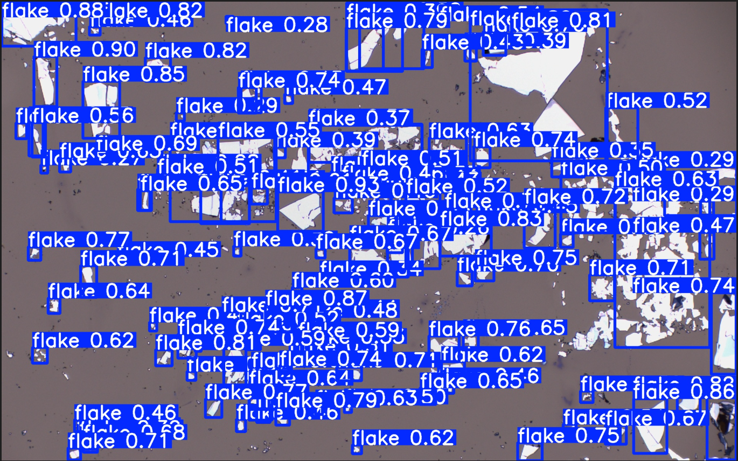
Yolo Recognition Model
In more sophisticated scenario

Slide 10
Edge Detection Model
We use edge detection as our baseline model to estimate the performance of our AI classification model

Slide 11
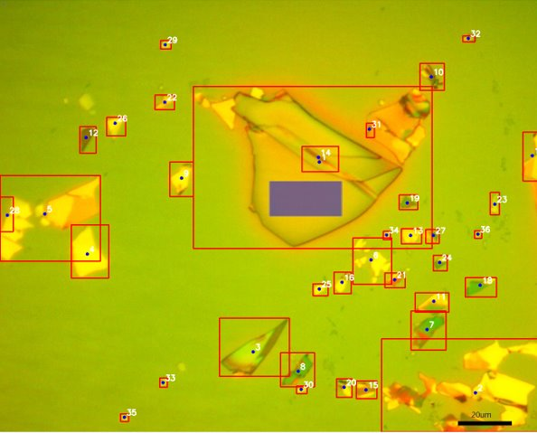
Edge Detection
Process Steps:
Detect sharp edges in the image using Canny edge detection.
Connect and close edges to form solid regions.
Identify closed regions by extracting their outer contours and treating each connected region as a flake.
Compute the centroid and bounding box for each flake to determine its location and size

Slide 12
Experimental Platform & Model Configuration
Models Evaluated
YOLOv8-Nano (lightweight model)
YOLOv8-Small (higher-capacity model)
Classical Edge Detection (non-ML baseline)
Input Resolution
640 × 640 (lower compute cost)
1024 × 1024 (higher spatial detail)
Platform
Raspberry Pi 5 (4GB RAM)
Controlled Conditions
Identical image dataset
Metrics Collected
Average execution time
CPU average and peak usage
Model storage footprint

Slide 13
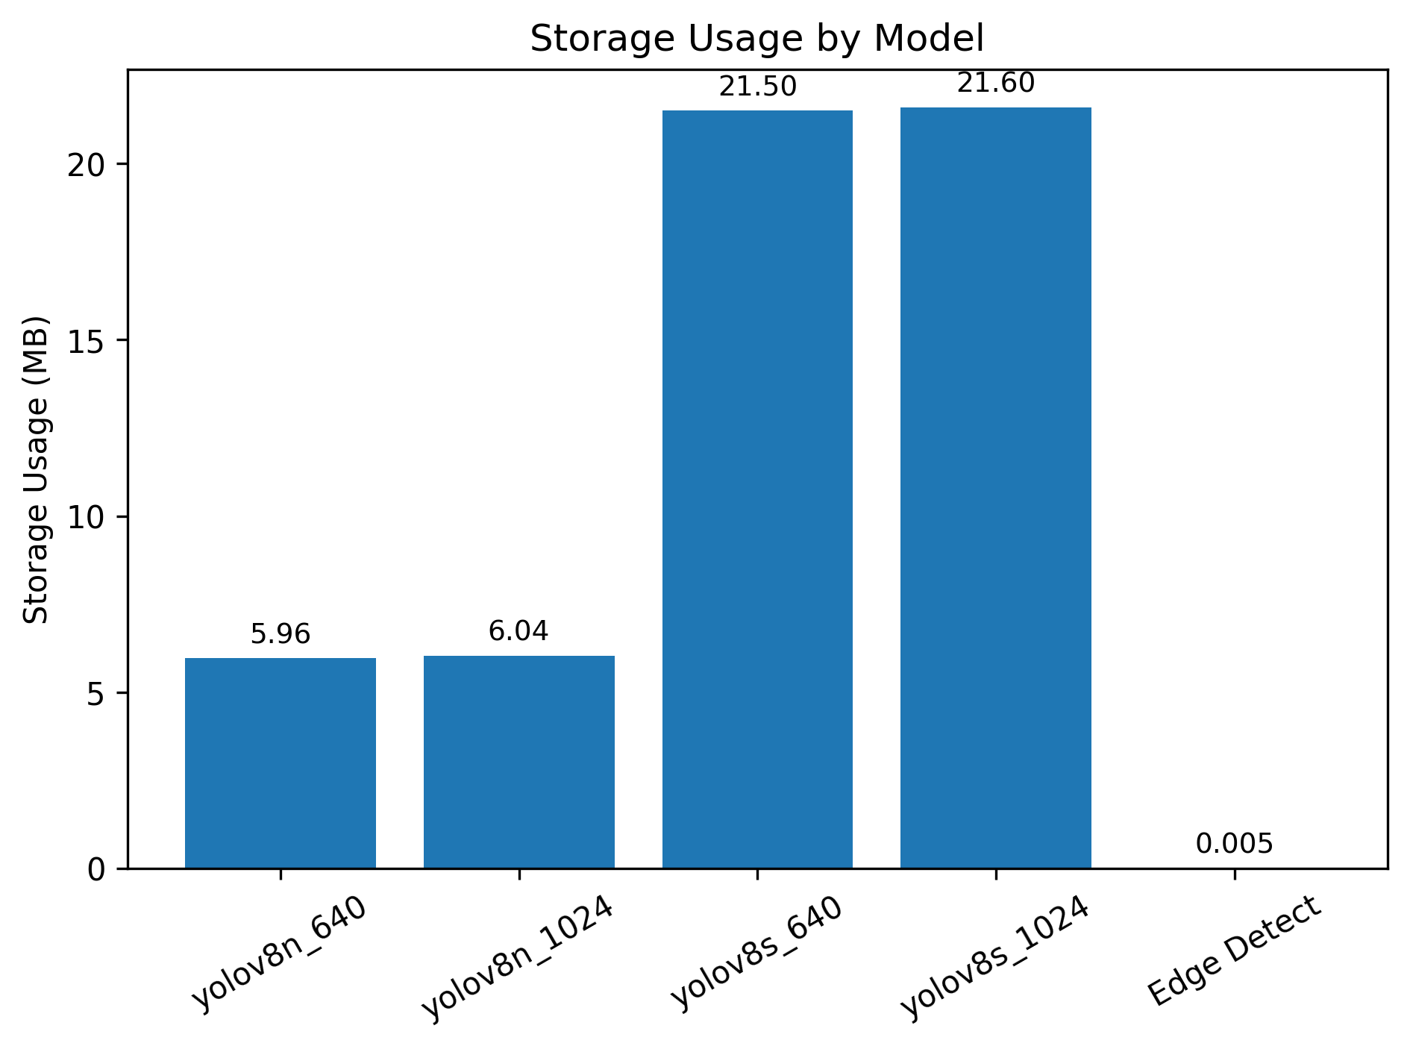
Result Analysis: Storage Usage
YOLO: Model size dominates storage cost; resolution has less effect.
Edge Detection: Minimal storage overhead, requiring only kilobytes of code and parameters.
Notes:
Edge detection is more portable, as it requires minimal storage and does not rely on a hardware-intensive training phase.

Slide 14
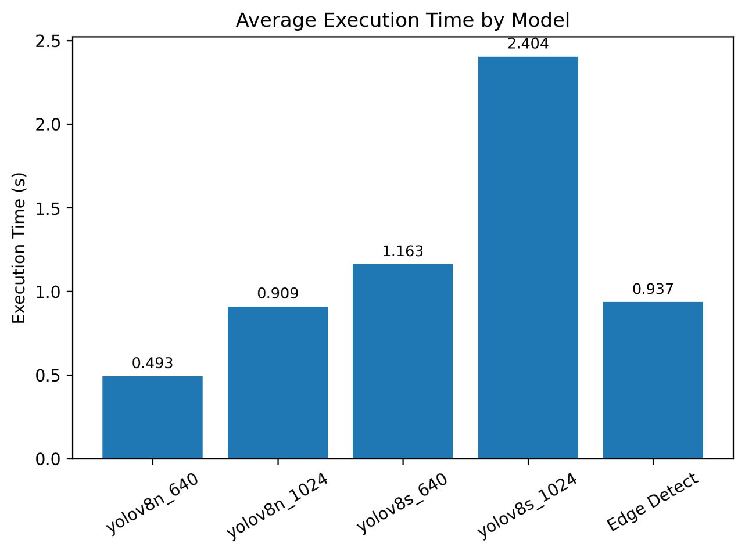
Result Analysis: Execution time
YOLO: Average execution time scales with both model capacity and input resolution.
Edge Detection: Surprisingly not the fastest algorithm

Slide 15
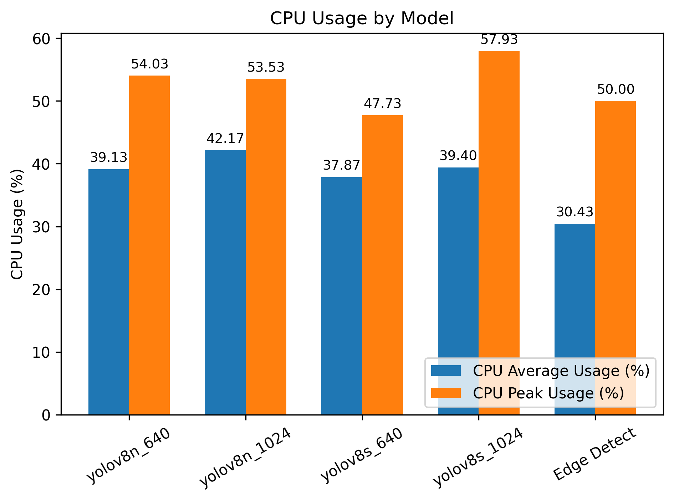
Result Analysis: CPU Usage
YOLO & Edge Detection Have no significant difference ON CPU Usage
Short execution bursts
limited parallelism
Notes:
YOLO’s neural inference and edge detection’s filtering operations both execute in short, compute-intensive bursts, resulting in similar peak CPU usage.
Both implementations may not fully exploit all CPU cores, causing similar average CPU utilization despite different algorithms.

Slide 16
Future Work
Preprocess imaging data to stitch individual video frames into a single composite overview image
Integrate detection algorithms with the motor control system to enable automated motion based on detected flakes
Validate and characterize the performance of the fully integrated system
Enhance flake detection algorithms for higher accuracy and robustness

